Slide 1
A Comprehensive Evaluation Inspection of AMC – WSG LLC
Inspector B. Benson
March 31, 2025
Ann Arbor, MI 48105

Slide 2
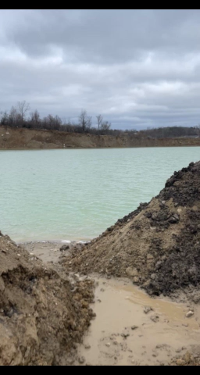

Video img_3935. Likely facing west, a view of Pond 2.

Slide 3
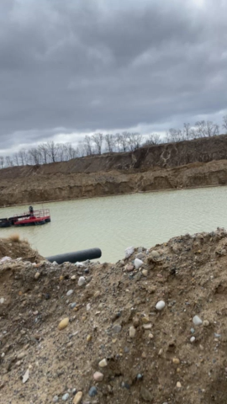
Video img_3936. Likely facing west, a view of Pond 3.

Slide 4
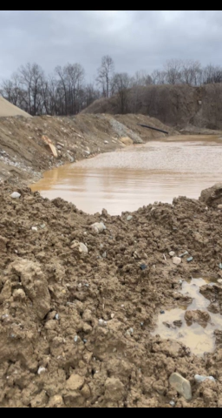
Video img_3937. Facing south east a view of Pond 4.

Slide 5
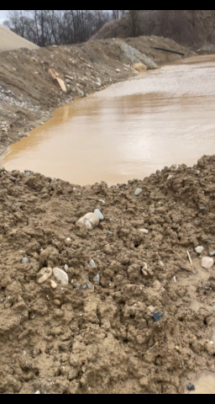
Video img_3938. Facing south, a view of Pond 4 with wash water actively discharging to the pond from the trench leading to the pond.

Slide 6
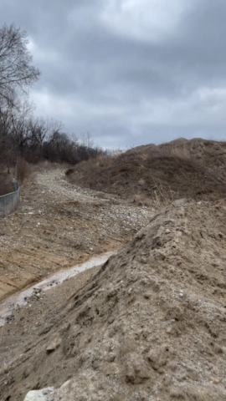
Video img_3839. Facing west and panning east, a view of a massive berm along the south border of the mine. Behind the berm was a trench that extended along the southern border of the plant to collect rain run off from the main plant area.

Slide 7
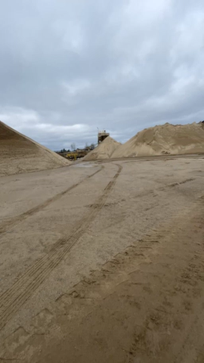
Video img_3940. Facing north a view of the classification device and the stock piles formed after classification.

Slide 8
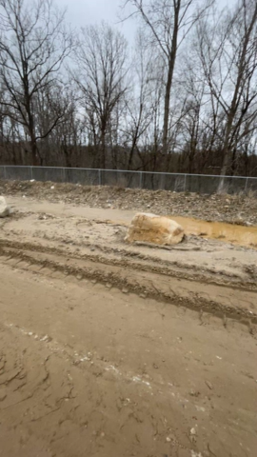
Video img_3941. Facing south and panning east, a second view of the trench along the southern border of the facility.

Slide 9
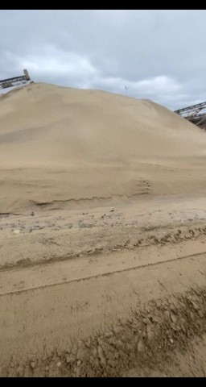
Video img_3942. Facing north west, a second view of the classifier.

Slide 10
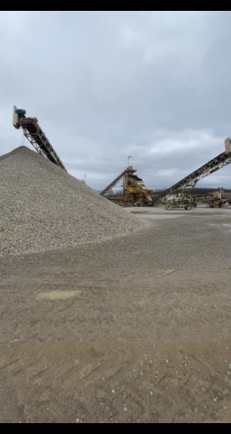
Video img_3943. Facing west, a view of several screeners that sieves the product into different sizes.

Slide 11
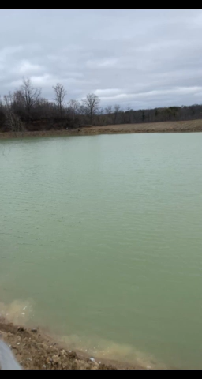
Video img_3944. Facing east, a view of Pond 1 with a green over flow pipe to Pond 2.

Slide 12
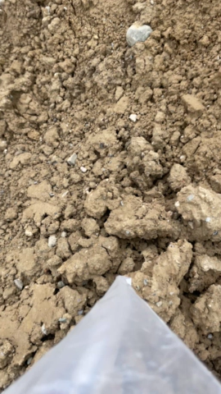
Picture img_3945. Facing east and traveling west to Pond 2, a view of Pond 1, east and tracing the overflow pipe to Pond 2 which was not visible at the time of evaluation.

Slide 13
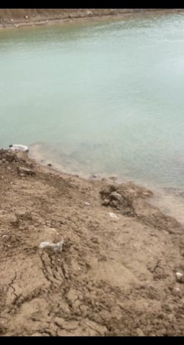
Video img_3946. Facing west, an additional view of Pond 2.

Slide 14
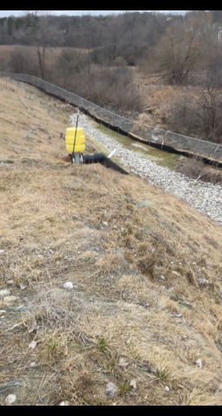
Video img_3947. Facing north, a view of the NPDES discharge location.

Slide 15
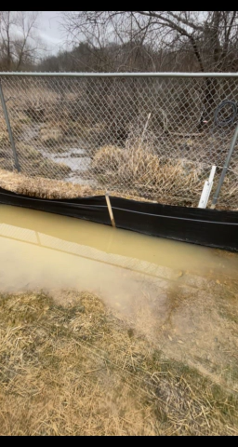
Video img_3948. Facing north, a view of a silt fence at the north border of the facility north of the NPDES discharge location.

Slide 16
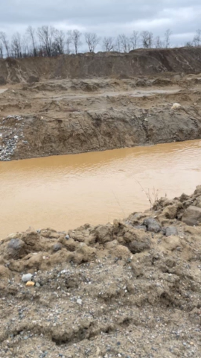
Video img_3949. Facing west, a view inlet pipe at the trench discharging to pond 4.

Slide 17
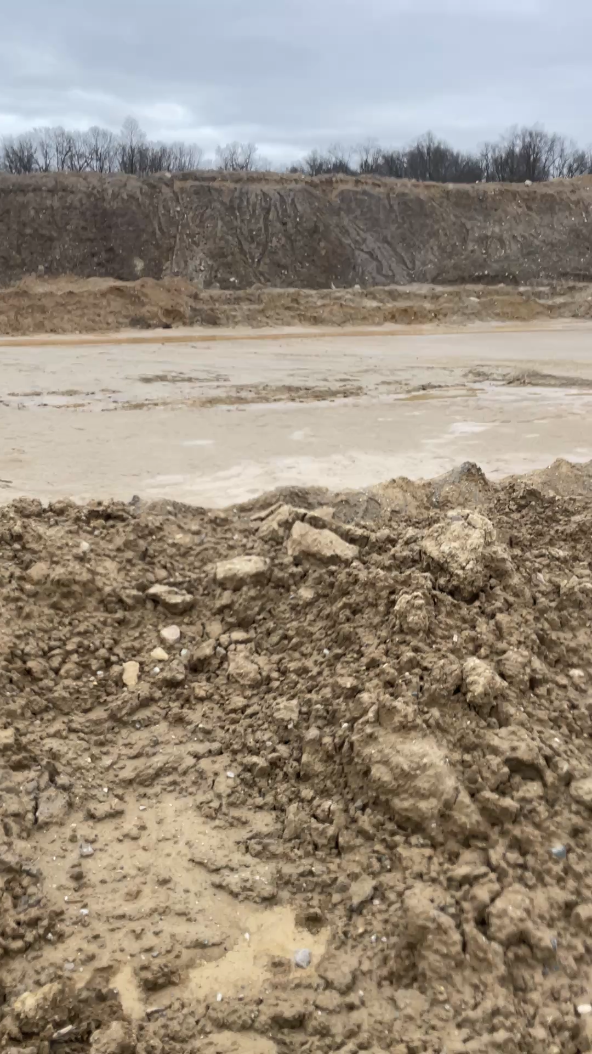
Video img_3950. Facing south a view of pond 4.

Slide 18
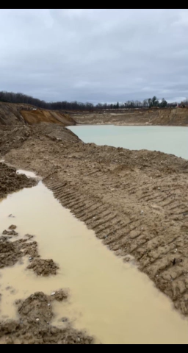
Video img_3951. Facing southwest, a view of Pond 3.

