Slide 1

Modern Water Law, Second Edition. Chapter 3: Riparian Law
Robin Kundis Craig,
Robert W. Adler, and
Noah D. Hall

Slide 2
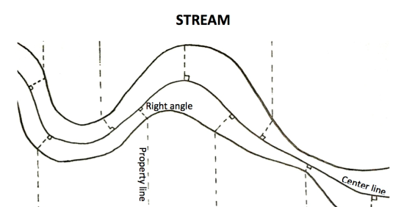
Division of Non-Navigable Stream Beds

Slide 3
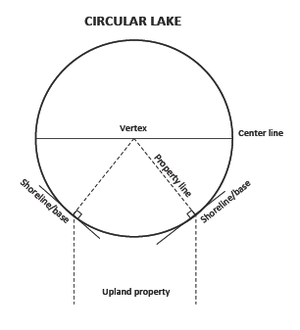
Division of Non-Navigable Circular Lakebed

Slide 4
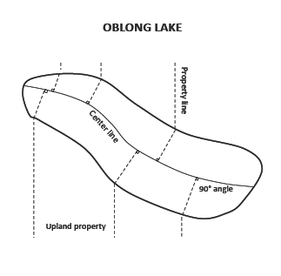
Division of Non-Navigable Oblong Lakebed

Slide 5
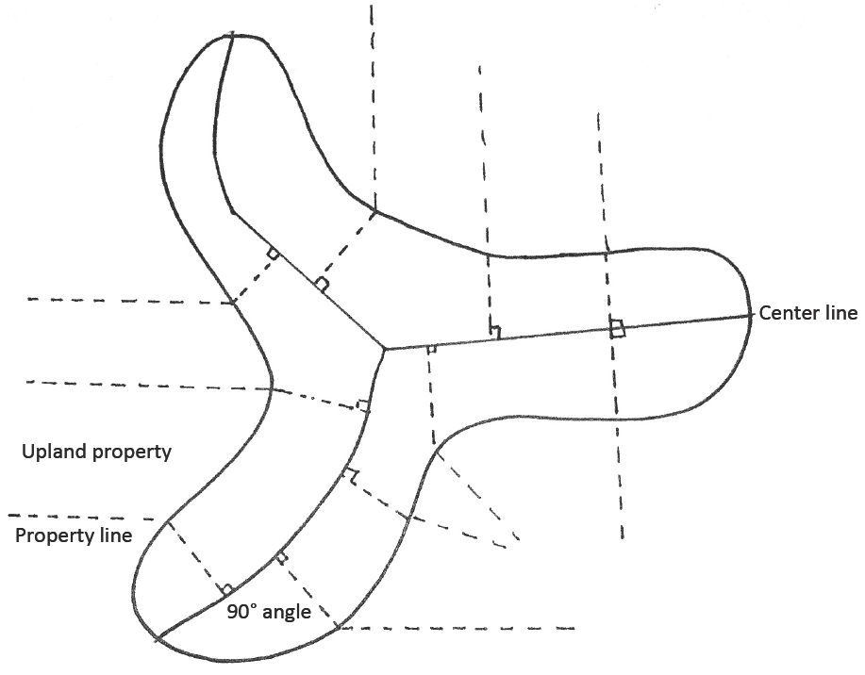
Division of Non-Navigable Irregular Lakebed

Slide 6
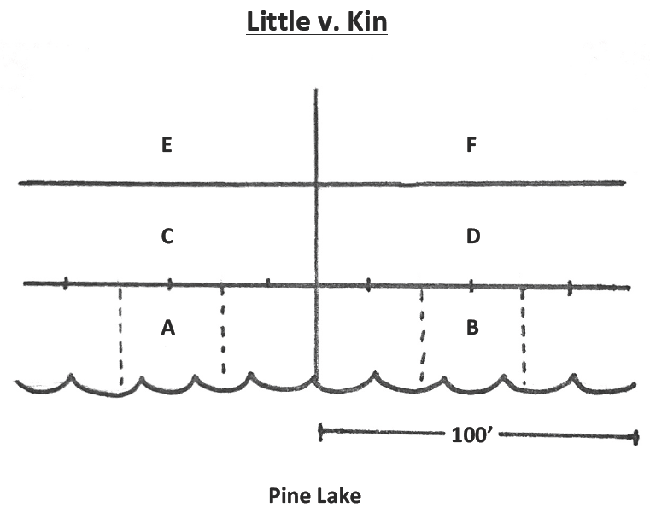
Little v. Kin Property Subdivisions

Slide 7
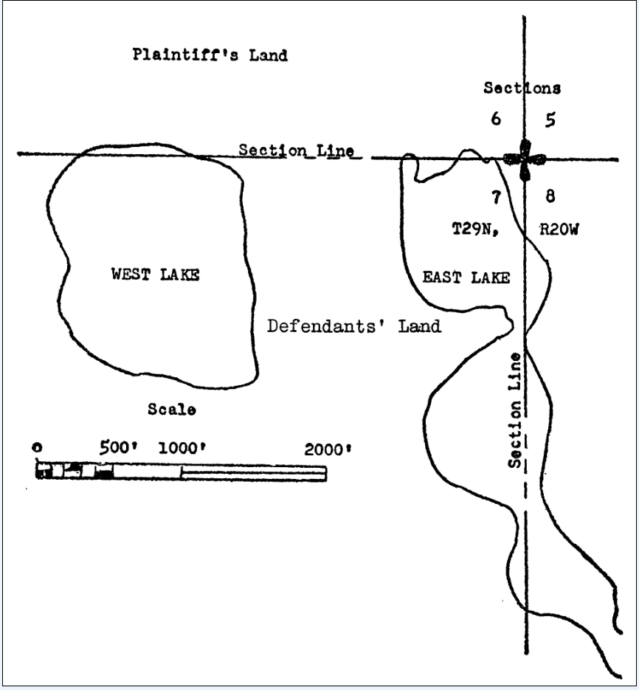
Johnson v. Seifert Property Map

