Slide 1

Modern Water Law, Third Edition. Chapter 13: Protecting and Restoring Watersheds and Water Systems
Robin Kundis Craig,
Robert W. Adler, and
Noah D. Hall

Slide 2
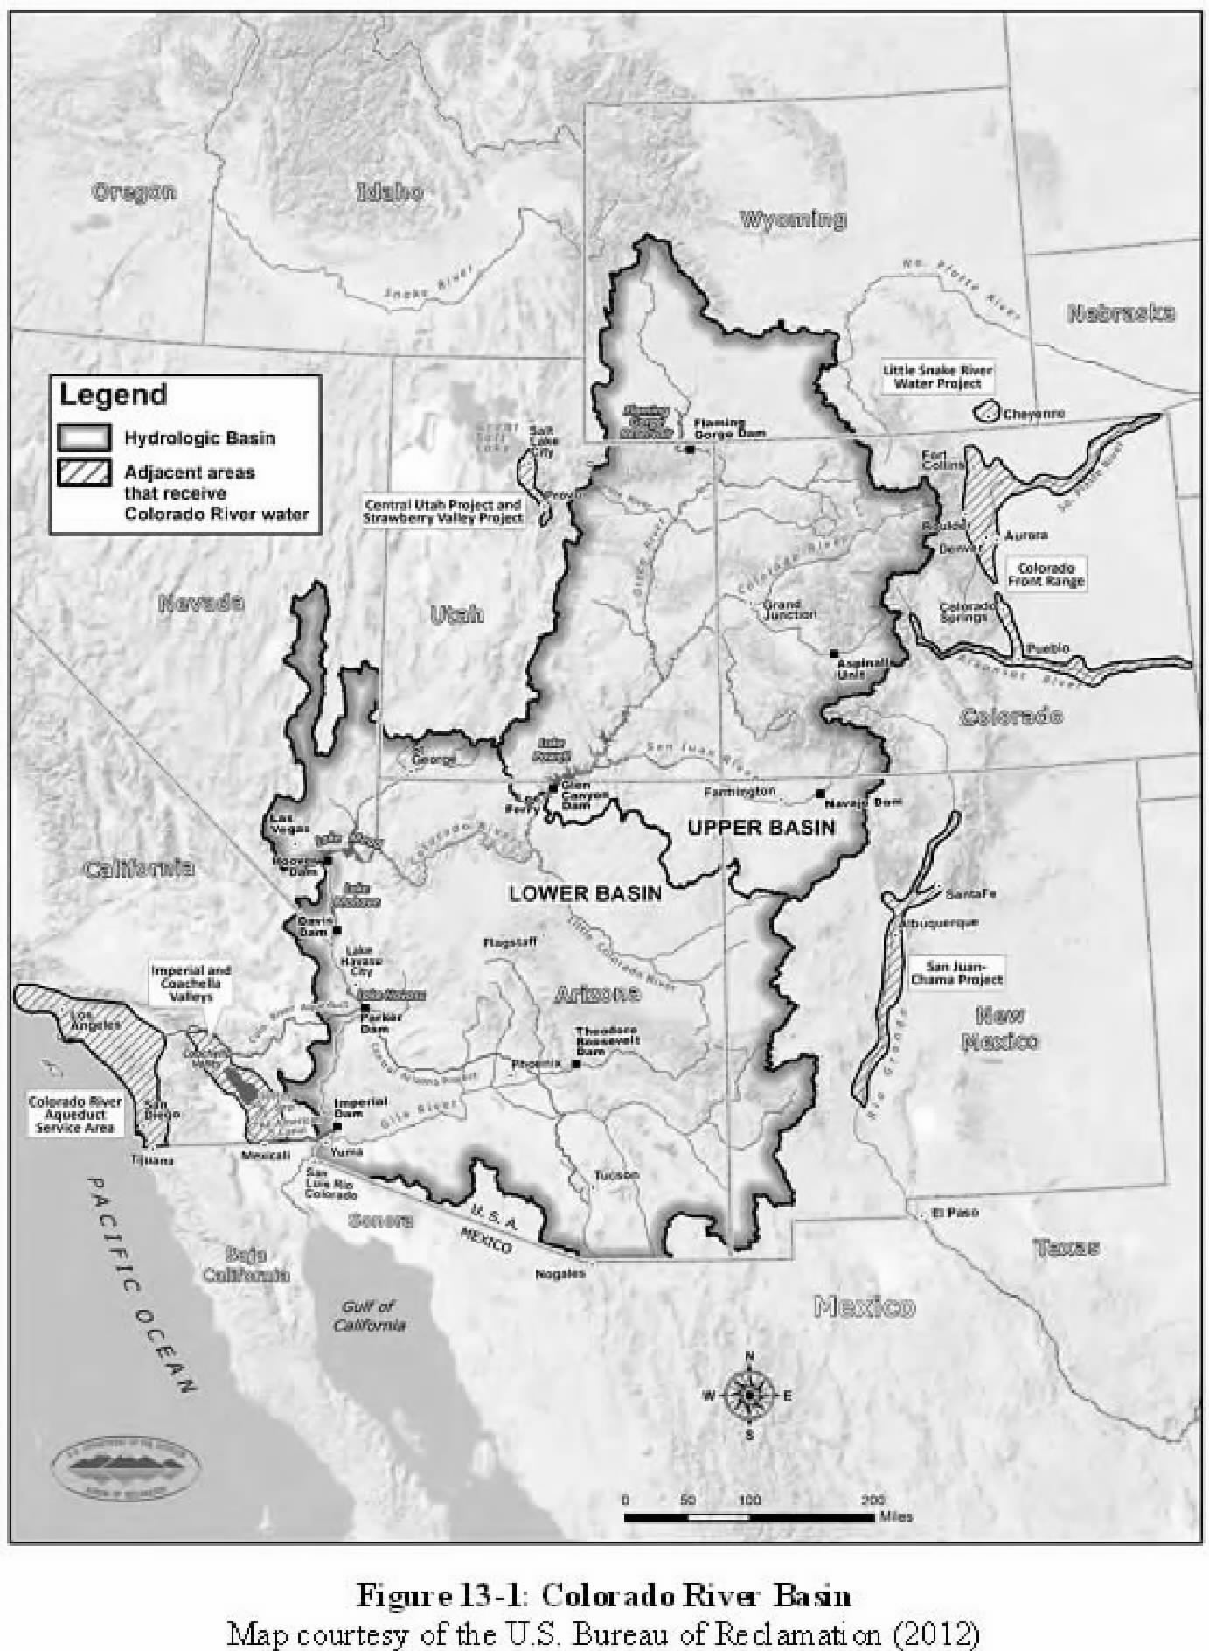

Slide 3
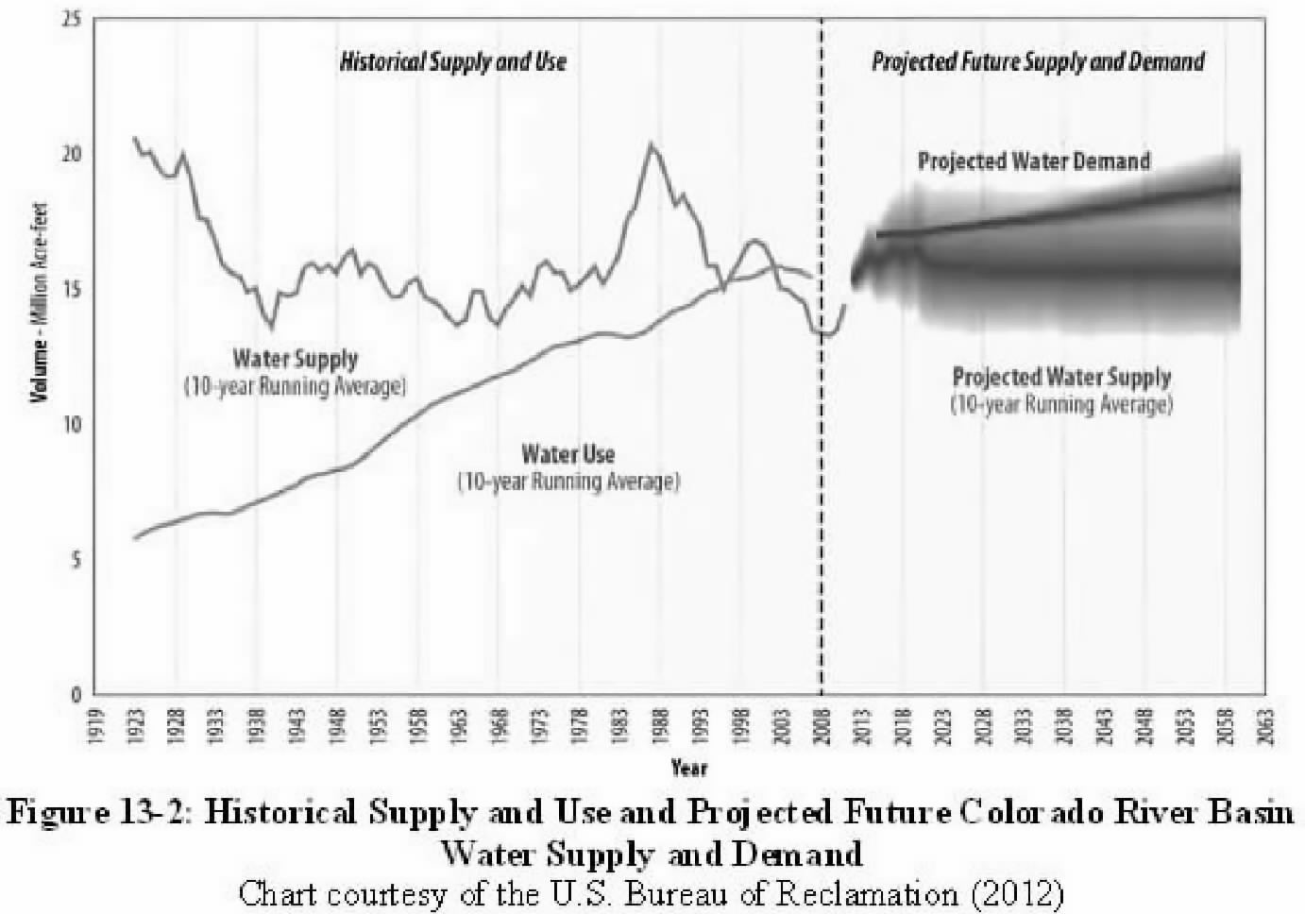

Slide 4
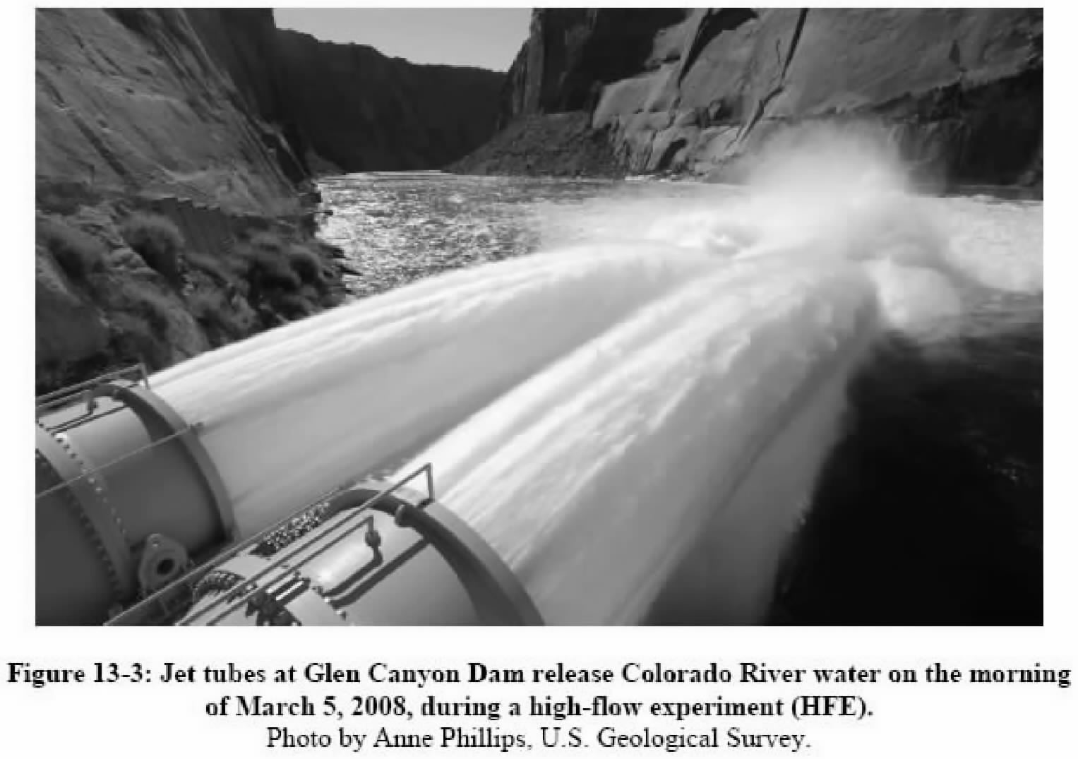

Slide 5
