Slide 1

Modern Water Law, Third Edition. Chapter 12: The Federal Endangered Species Act, Water Management, and Water Rights
Robin Kundis Craig,
Robert W. Adler, and
Noah D. Hall

Slide 2
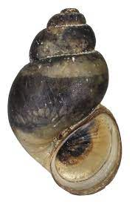
Figure 12-1: Bruneau Hot Springs Snail
Photograph courtesy of the U.S. Fish & Wildlife Service

Slide 3
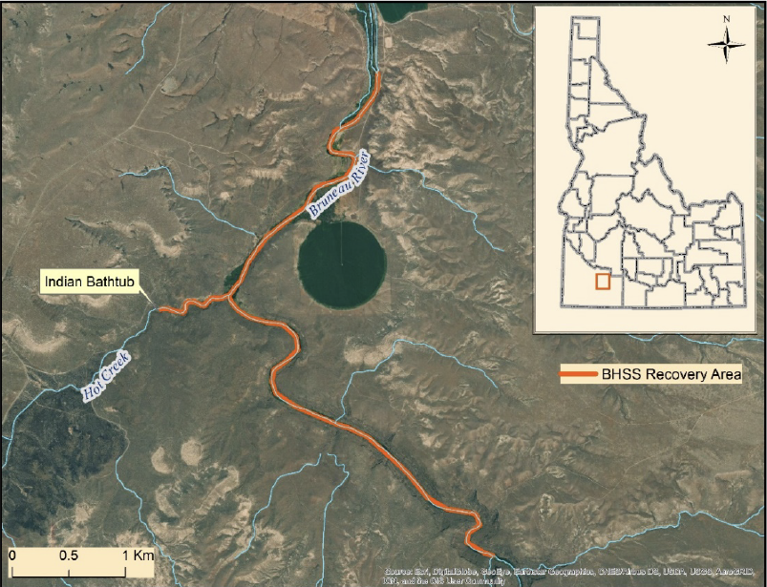
Figure 12-2: Bruneau Hot Springs Snail Historic
Range
Figure courtesy of the U.S. Fish & Wildlife Service.

Slide 4
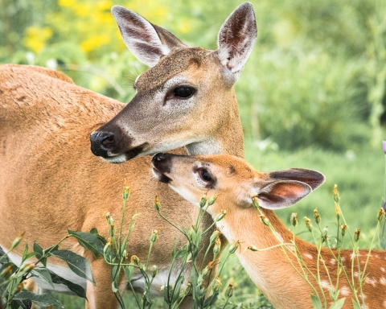
Figure 12-3: Key Deer
Photograph courtesy of the U.S. Fish & Wildlife Service

Slide 5
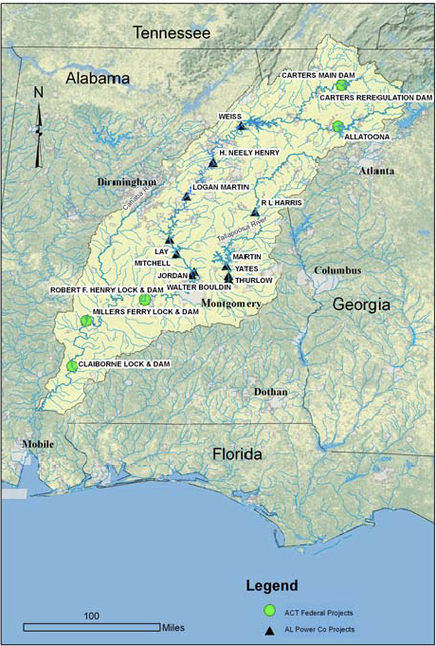
Figure 12-4: The Alabama-Coosa-Tallapoosa
River Basin, Showing the Coosa River Hydroelectric Dams
Map courtesy of the U.S. Army Corps of Engineers

Slide 6
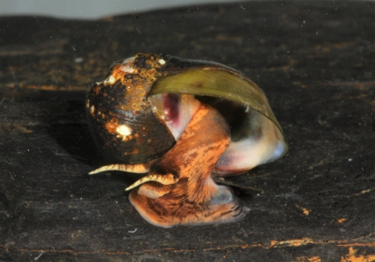
Figure 12-5: The Painted Rocksnail, One of the Many ESA-Listed
Species in the Coosa River
Photograph courtesy of the U.S. Fish & Wildlife Service

Slide 7
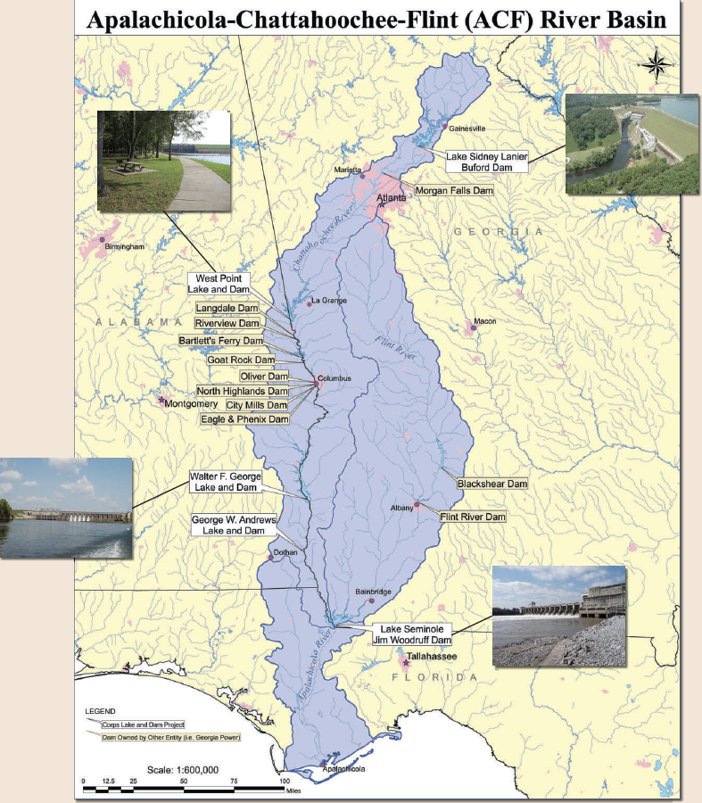
Figure 12-6: Army Corps Dams in the
Apalachicola-Chattahoochee-Flint River Basin
Map courtesy of the U.S. Army Corps of Engineers.

Slide 8
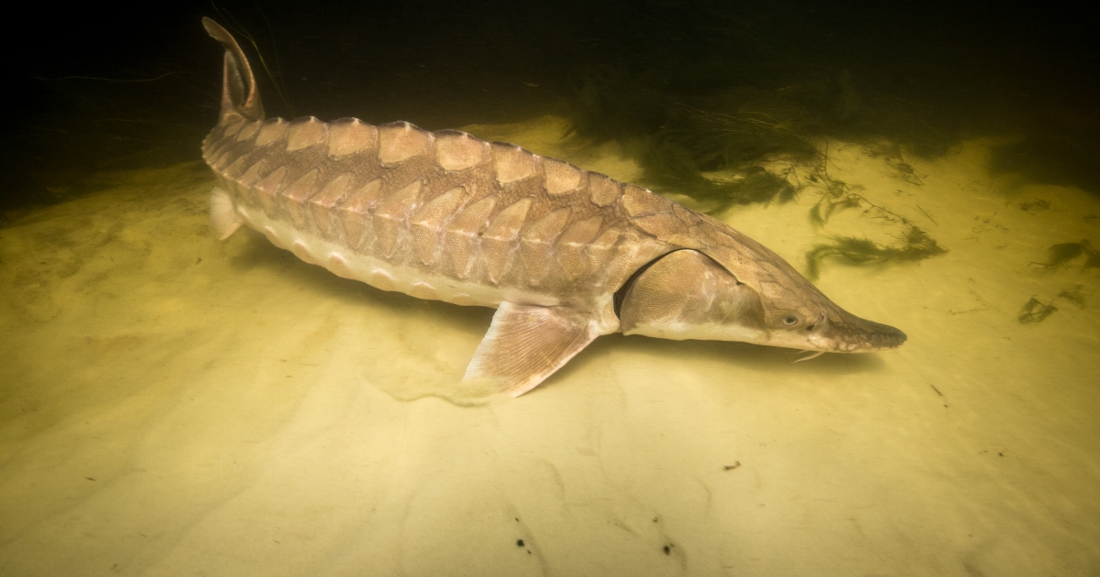
Figure 12-7: Gulf Sturgeon
Photograph courtesy of the U.S. Fish & Wildlife Service.

