Slide 1

Modern Water Law, Third Edition. Chapter 10: The Water-Energy Nexus
Robin Kundis Craig,
Robert W. Adler, and
Noah D. Hall

Slide 2
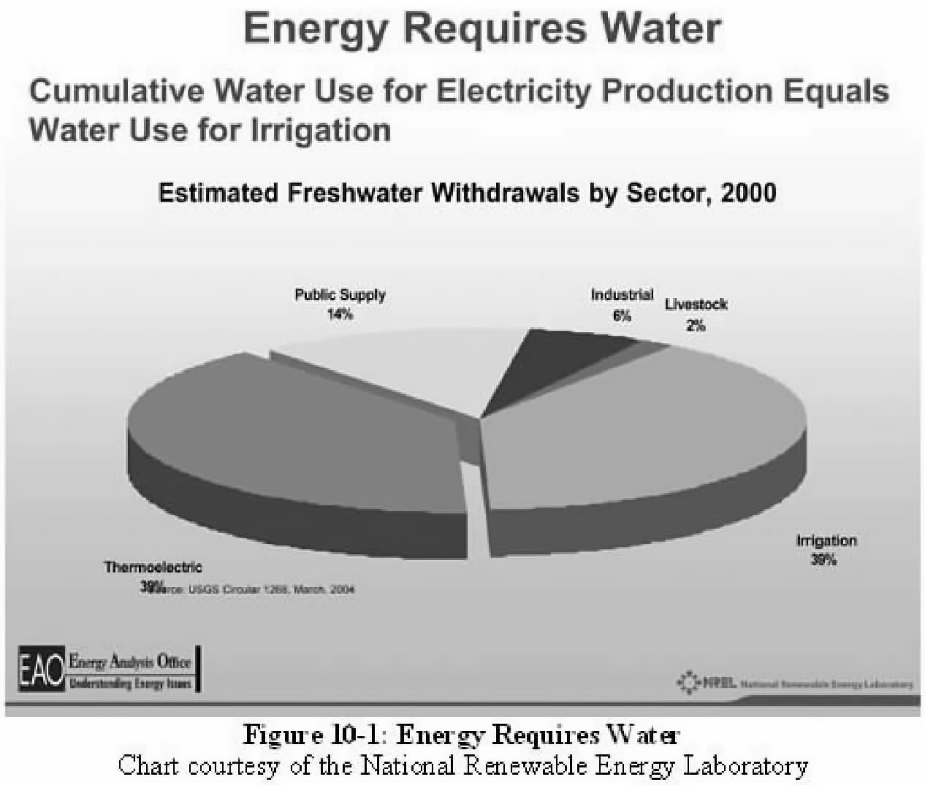

Slide 3
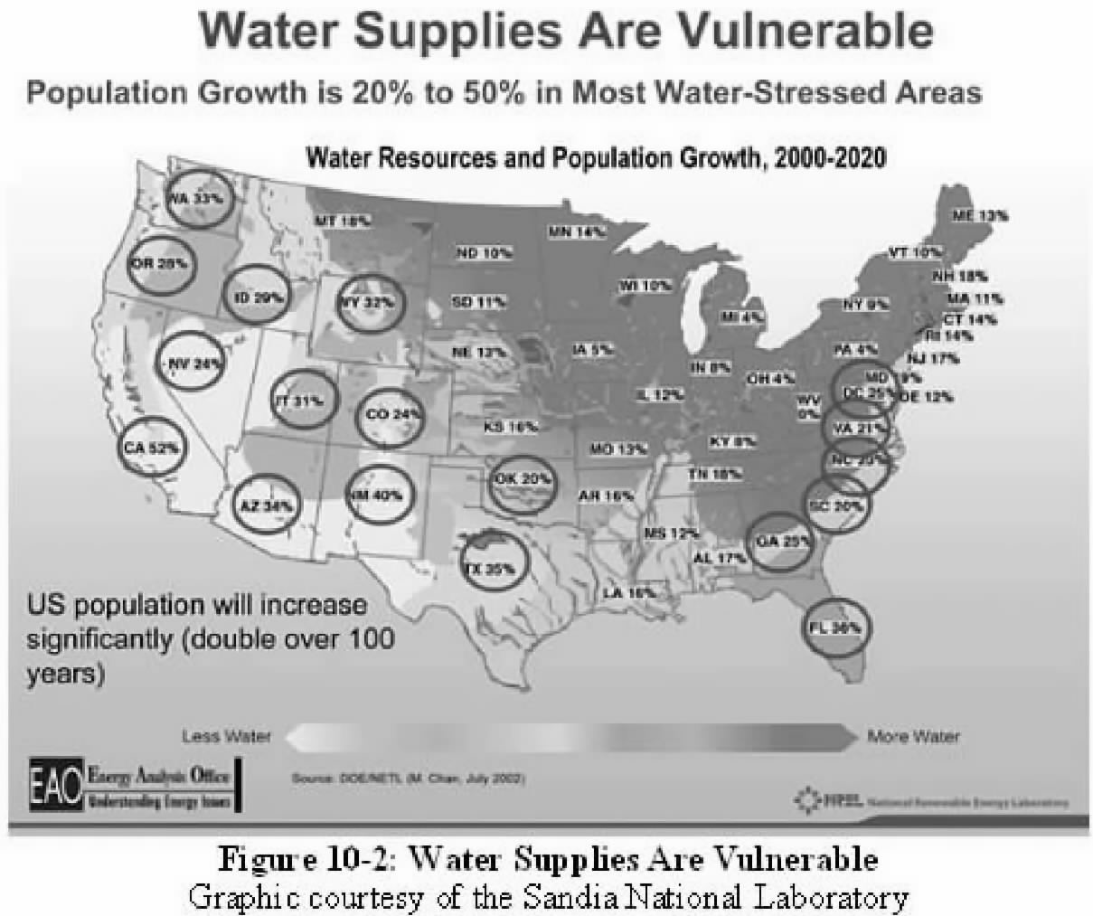

Slide 4
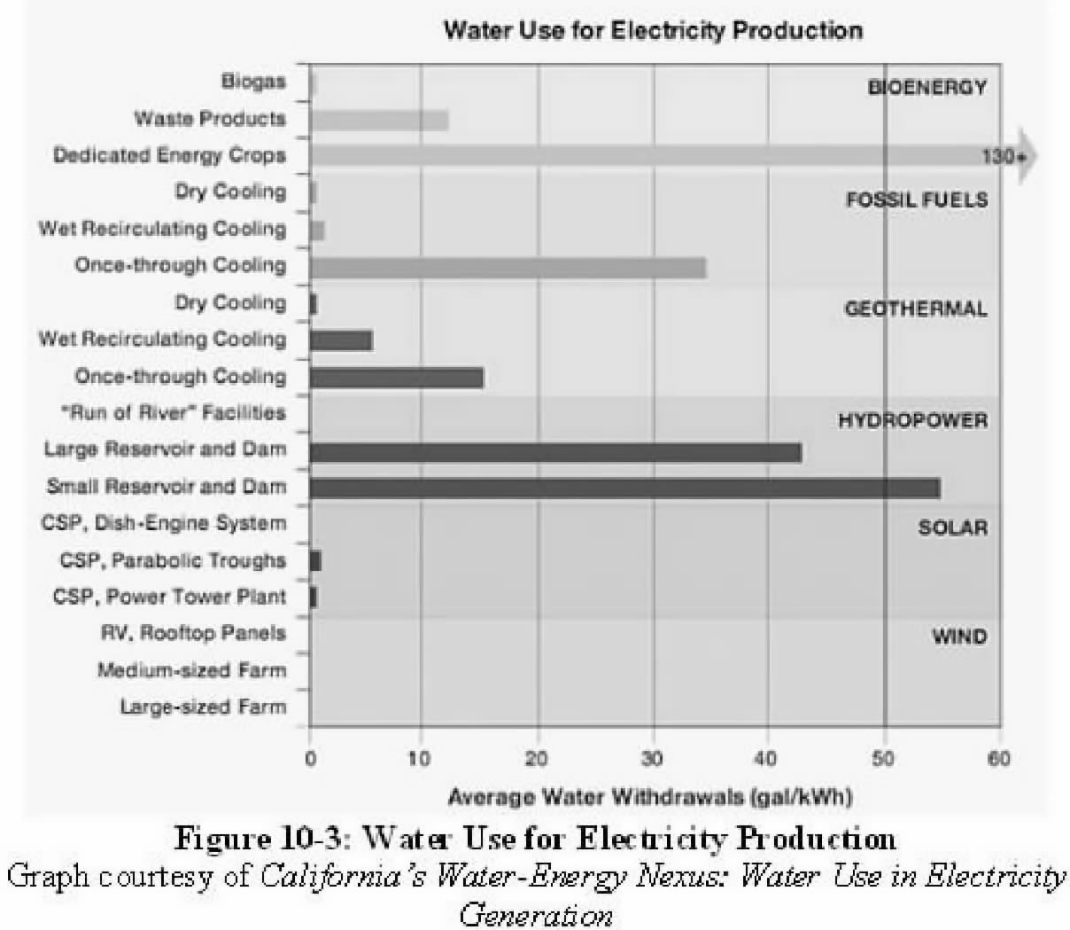

Slide 5
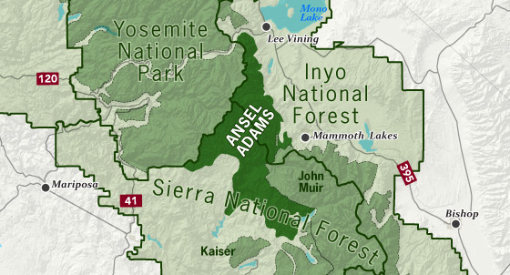
Figure 10-4: Location of Inyo National Forest
SOURCE: Sierrawild.gov, https://www.sierrawild.gov/wilderness/ansel-adams/

Slide 6
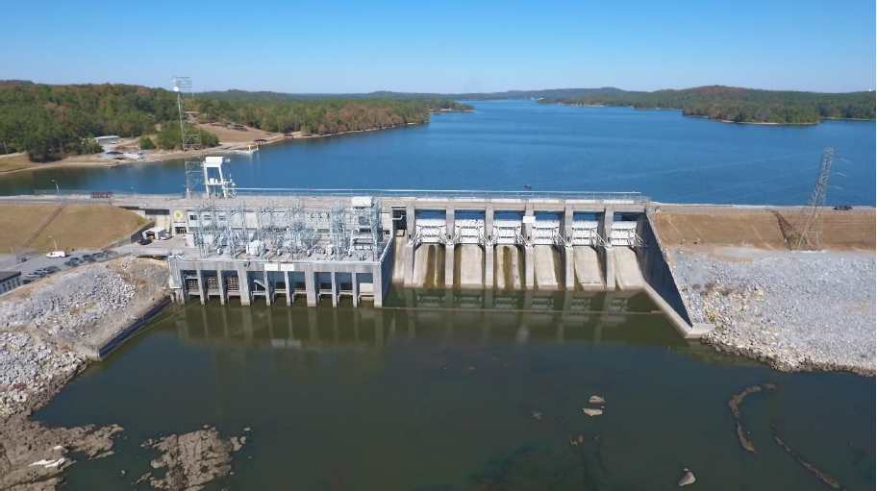
Figure 10-5: Logan Martin Dam on the Coosa River
SOURCE: U.S. Army Corps of Engineers, https://‌www.‌sam.‌usace.‌army.‌mil/‌Portals/46/docs/planning_environmental/act/docs/ACR/06_ACR%20FR-SEIS-Appendix%‌20A_A5%‌20Logan%‌20Martin%‌20Lake%‌20WCM.‌pdf?ver=WKaIf50Yy_leXTI32AgUBA%3D%3D

Slide 7
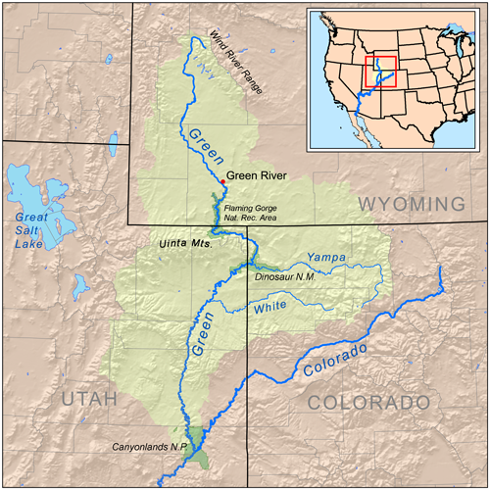
Figure 10-6: Green River
SOURCE: Wikipedia, used in conformance with Creative Commons license

Slide 8
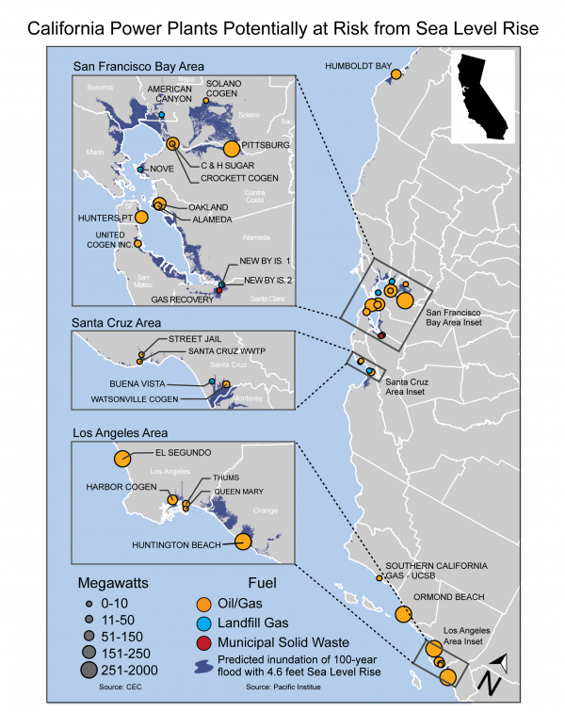
Figure 10-7: California Power Plants Potentially at Risk from
Sea Level Rise
SOURCE: U.S. Global Change Research Program, https://www.globalchange.gov/browse/multimedia/california-power-plants-potentially-risk-sea-level-rise

