Slide 1

Modern Water Law, Third Edition. Chapter 1: Introduction
Robin Kundis Craig,
Robert W. Adler, and
Noah D. Hall

Slide 2
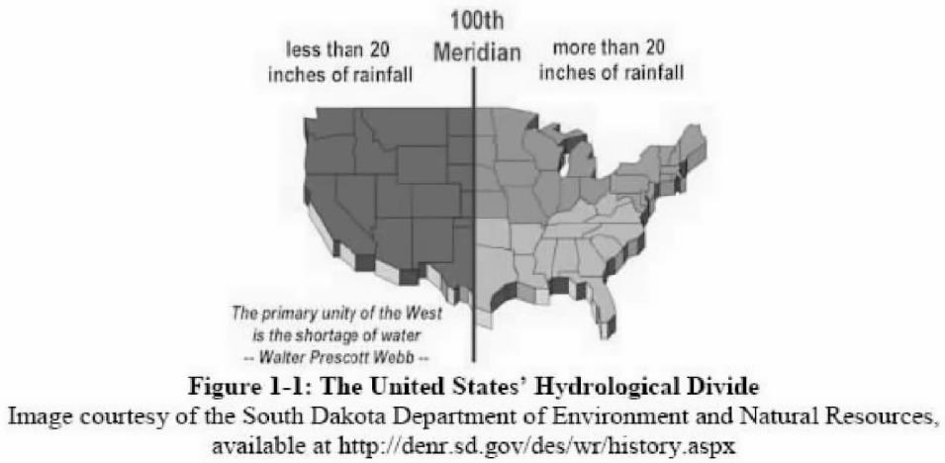

Slide 3
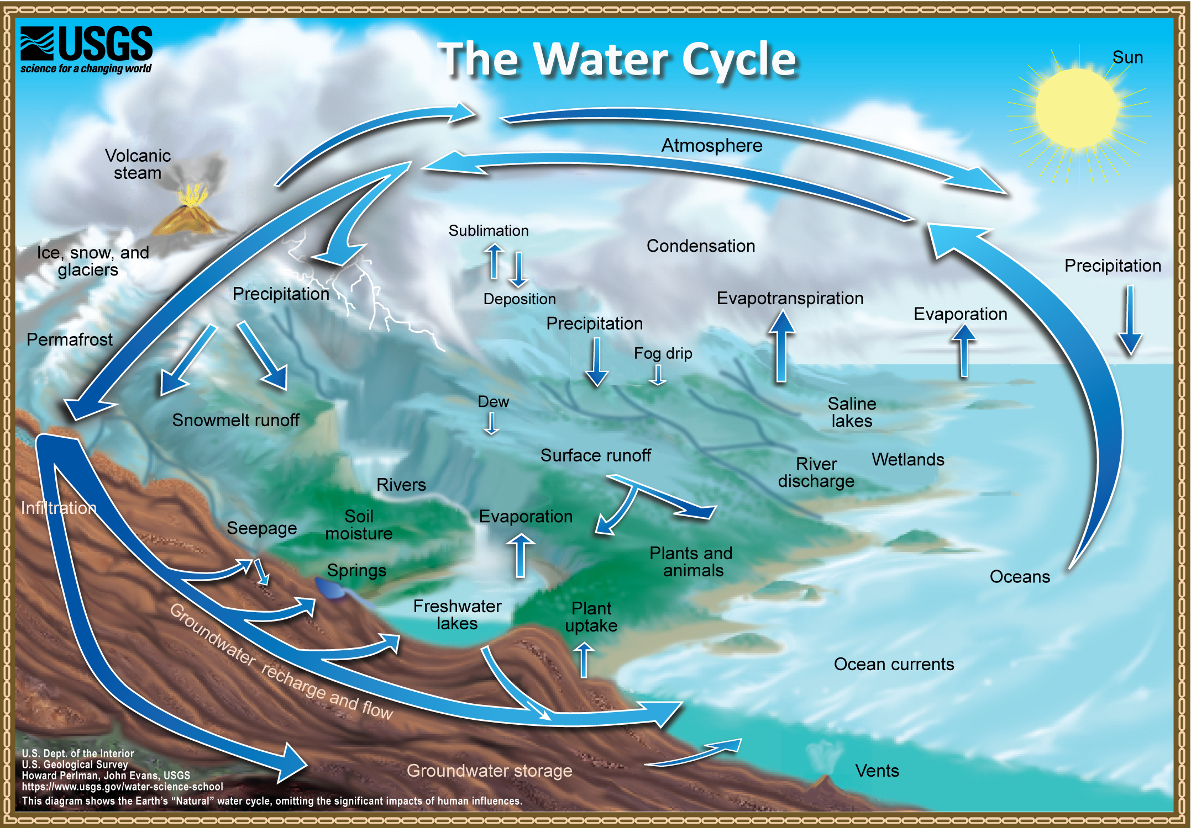
Figure 1-2: The Water Cycle
SOURCE: U.S. Geological Survey, 2019

